Slide 1
Generative Artificial Intelligence Image Generation with Deep Learning Models
November 6, 2025
Pethő Gergely
UD Faculty of Health Science, Department of Bioinformatics

Slide 2
Two Main Areas of Generative AI
Generative AI has two main application areas today:
generation of written text in human languages, especially as part of a chatbot (ChatGPT, Gemini, Claude)
the user talks to the AI
special cases:
generation of audible, spoken text: mostly the same as generation of written text, but the generated text is read aloud by a speech synthesis application
generation of program code: text, but not in a natural, but rather in a programming language
generation of linear sequences (a series of words)
image generation
not a sequence, but a two-dimensional structure of some specific size, consisting of a certain number of pixels
special case: video generation, a cohesive sequence of such individual images

Slide 3
Image Generation
Always happens using deep neural networks
Main technical solutions:
VAE: variational autoencoder
GAN: generative adversarial network
autoregressive model: generates an image as a sequence of pixels similar to text generation
regressive: generates (essentially predicts) the next element using a mechanism similar to logistic regression
auto: input and output are of the same kind, both are pixels (input: a sequence of pixels, output: the next pixel, and ultimately also a sequence of pixels when used repeatedly
diffusion
Important: the output of the model is of a different nature compared to text generation, and thus it follows that the same model is unable to generate an image on one occasion and text on another, this is only possible if two separate models are used
it is possible that some hidden layers closer to the input are shared between a language generation and an image generation model, i.e. these layers have the same weights in both
but their layers near the output layer are necessarily very different
ergo: if ChatGPT or Gemini can generate both text and images, these are surely not done by the same model, i.e. „one AI”, but rather multiple models attached to the same user interface: an image generator and a text generator (or several)

Slide 4
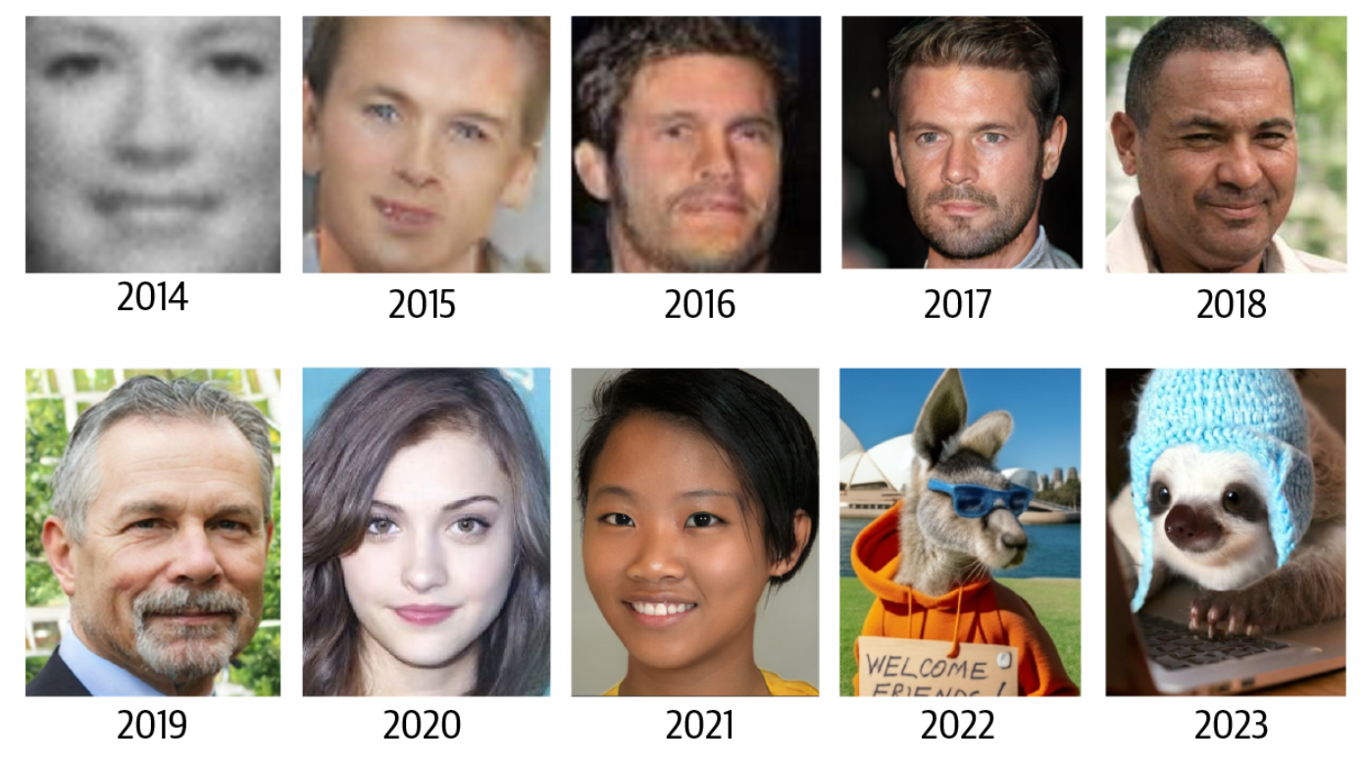
Development of Image Generation
2010s: GAN was the dominant technology
2020s: diffusion models
Source: Foster: Generative Deep Learning, 2nd ed., O’Reilly, 2024, 7.

Slide 5
Image Generation
Two main methods:
unconditioned generation: the model generates images freely
it is trained to learn the general features of images showing certain motifs (faces, cars, animals, etc.)
as a classification model or as an autoencoder
then the model is modified so that it will generate images similar to what it was trained on as predictions
conditioned generation: input can be (typically) text or images, output is the generated image
in: text, out: new image
in: image, out: modified image
in: text and image, out: modified image
in: two images (+ possibly text), out: combination of two images

Slide 6
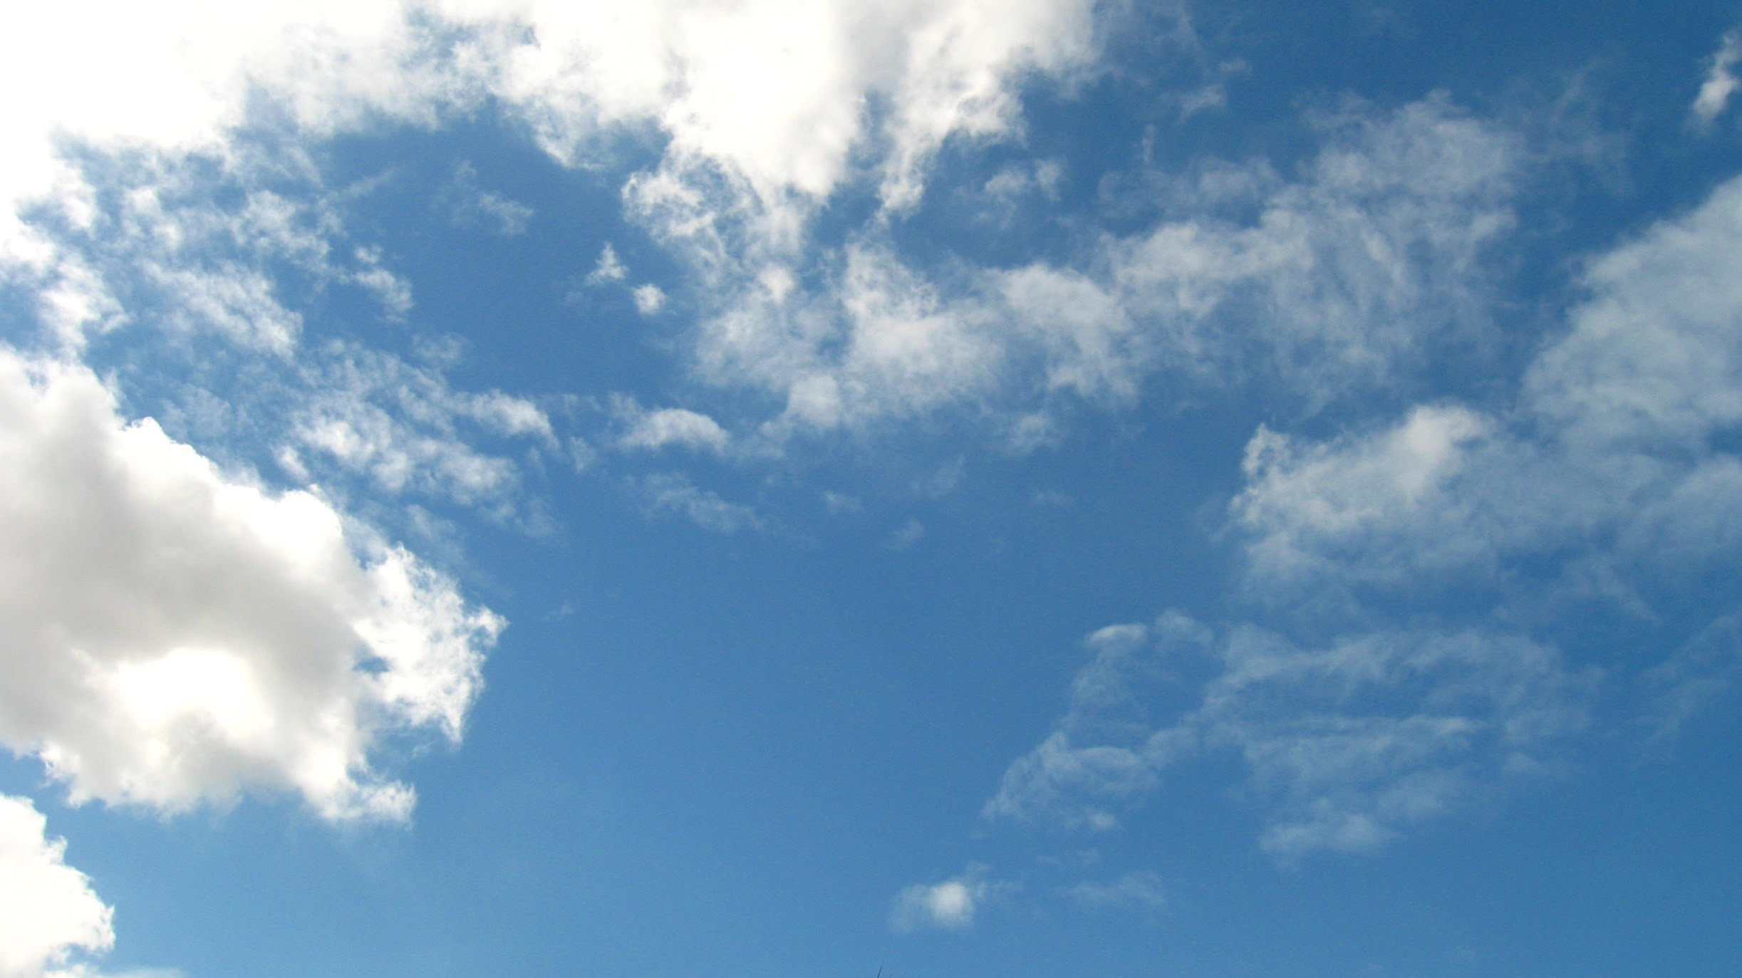
Forrás: Google Fotók

Slide 7
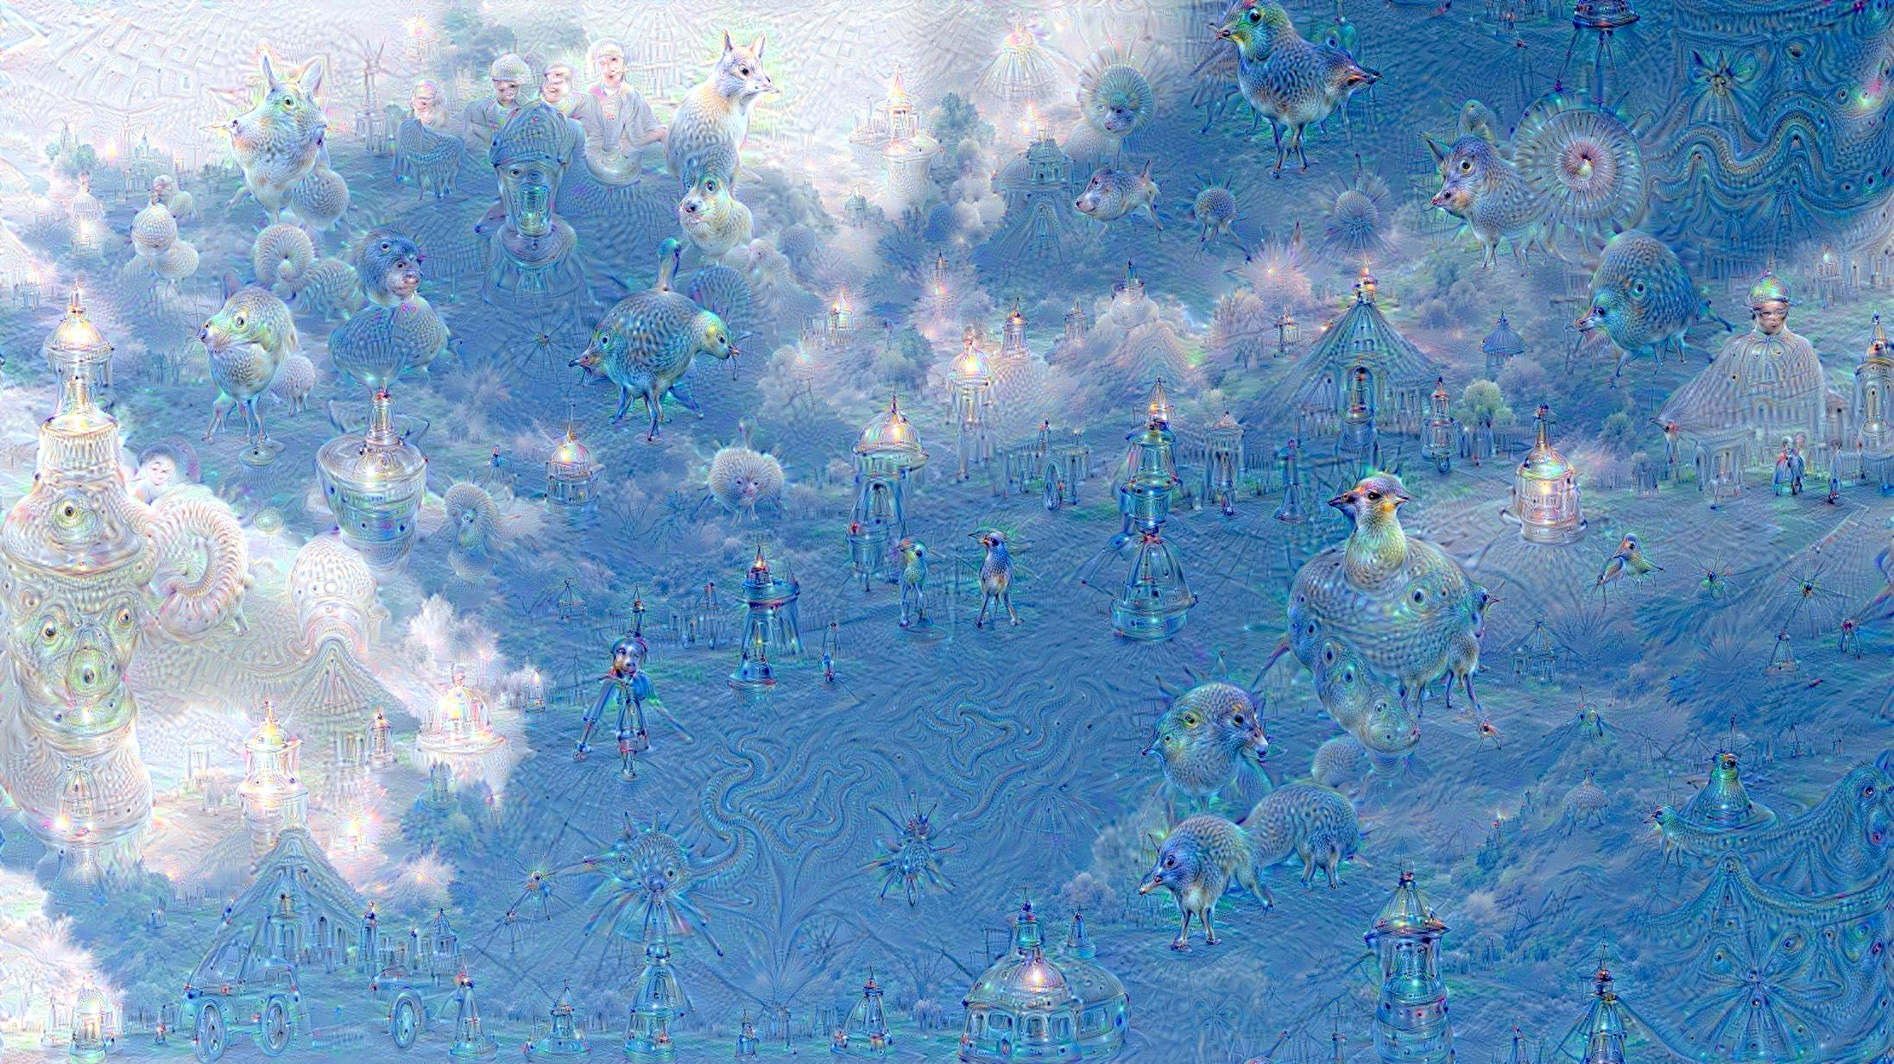
Forrás: Google Fotók

Slide 8
DeepDream
Beginnings: image generation based on convolutional neural networks (CNNs) in 2014/15, Google DeepDream
Problem: How to visualise what a CNN knows
One possibility: inspect its filters
Another option: give the trained model an image that can show anything, this is then classified by the model as a banana with e.g. confidence 0.00003; then apply gradient descent not to modify the model weights but rather the pixels of the input image so that the image would be recognised a bit more as a banana in the next iteration
Additional condition: the image needs to have similar statistical properties as a real image, e.g. neighboring pixel values are correlated
This idea was implemented by the application called DeepDream based on an image classification CNN called Inception
https://research.google/blog/inceptionism-going-deeper-into-neural-networks/

Slide 9
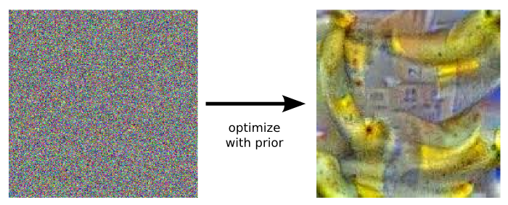
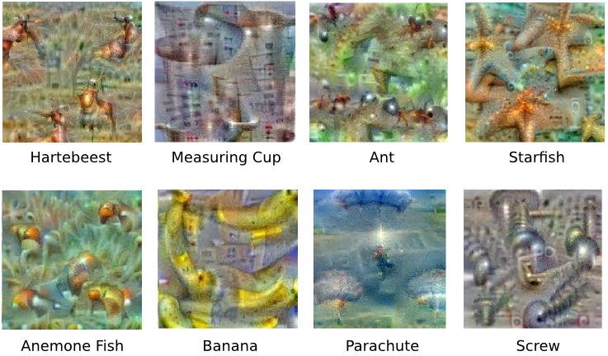
Starting out from random noise, we want the input image to be more banana-like; source: Google Photos
Source:
Google Photos

Slide 10
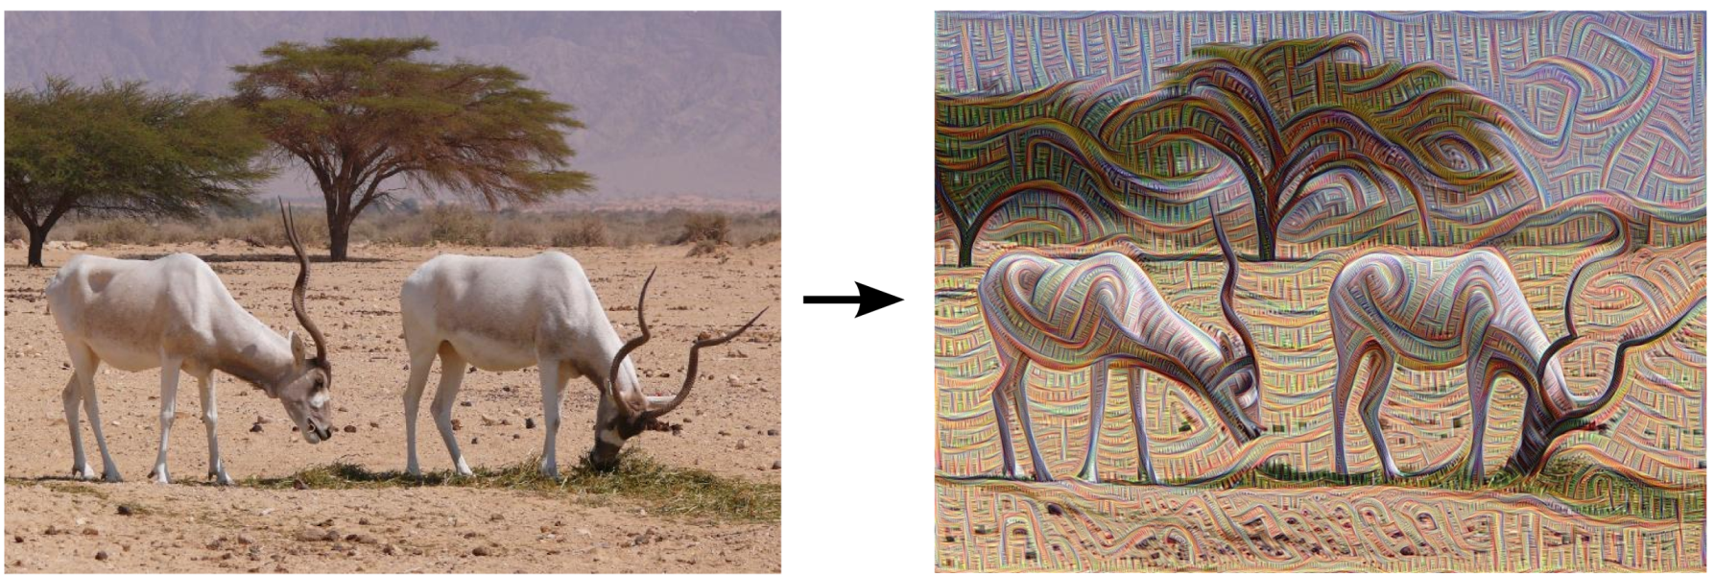
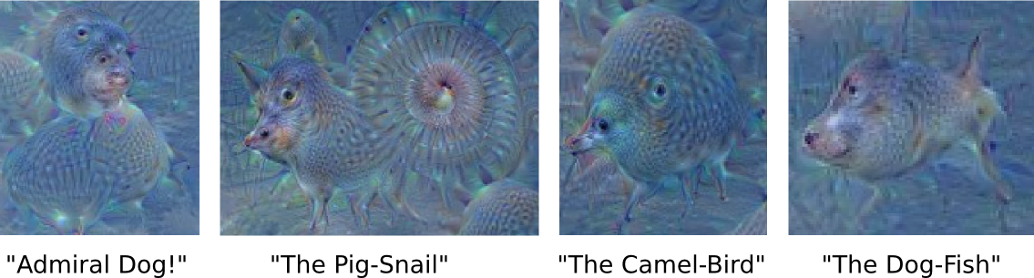
A different option: we do not adjust the image to correspond better to a category label, but in a way that the activation of filters in a certain layer of the network increases overall
Lower layers enhance the edges in the image, maybe even where there are no edges
By making the image increase the activation of filters on higher layers, patterns characteristic of the categories learned by the model appear; e.g. animals are „recognised” in the blue sky and clouds if the model was trained to recognise animals

Slide 11
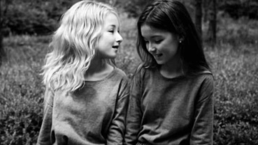
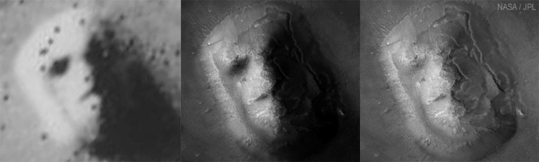
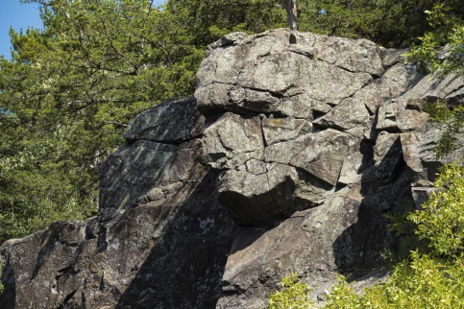
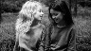
DeepDream
The name DeepDream refers to the fact that it generates dream-like images that resemble psychedelic hallucinations
This is usually claimed to be related to the phenomenon of pareidolia, which plays a role in human psychology
The part of the human brain responsible for visual processing (the visual cortex) recognised patterns, similarly to CNNs. It sometimes notices such patterns even in random noise where the pattern in question would not be interpretable in reality – it certainly is there, but only coincidentally.
we especially tend to recognise faces where there is not really a face
source, source, source

Slide 12
DeepDream
However, it is misleading to refer to pareidolia when talking about DeepDream
What is going on is not that the neural network interprets a pattern in an image e.g. as a banana even where it does not show a banana.
It rather inserts the image of a banana into an image that originally didn’t contain it, and where the image recognition model would not have recognised it either.
The parallel to human dreams and hallucination is much more appropriate
The visual cortex is for processing visual stimuli coming from the outside world; however, in these cases it does not recognise but generate images as if they corresponded to something in the outside world.
Similarly, CNN filters that would normally serve the purpose of image recognition are used, atypically, by DeepDream to generate motifs

Slide 13
Variational Autoencoder
Original publication: Kingma, Welling: Auto-Encoding Variational Bayes, 2013
Later overview of developments: Kingma, Welling: An Introduction to Variational Autoencoders, 2019
We are already familiar with the basic idea:
an autoencoder (= self-encoder) consists of two component parts:
encoder: transforms a high-dimensional input (usually an image) to a low-dimensional co-called latent vector
decoder: transforms the latent vector into a vector of the same dimensionality as the input
during training, the expected output of the decoder is identical to the input of the encoder (therefore auto-)
the aim of training is thus to let the autoencoder transform the latent vector back to a vector as similar to the input vector as possible
the latent vector is a lossy-compressed form of the input
the autoencoder learns how to compress the input to a certain dimensionality so that the compressed representation of the input retains the most information, i.e. it learns a dimensionality reduction procedure

Slide 14
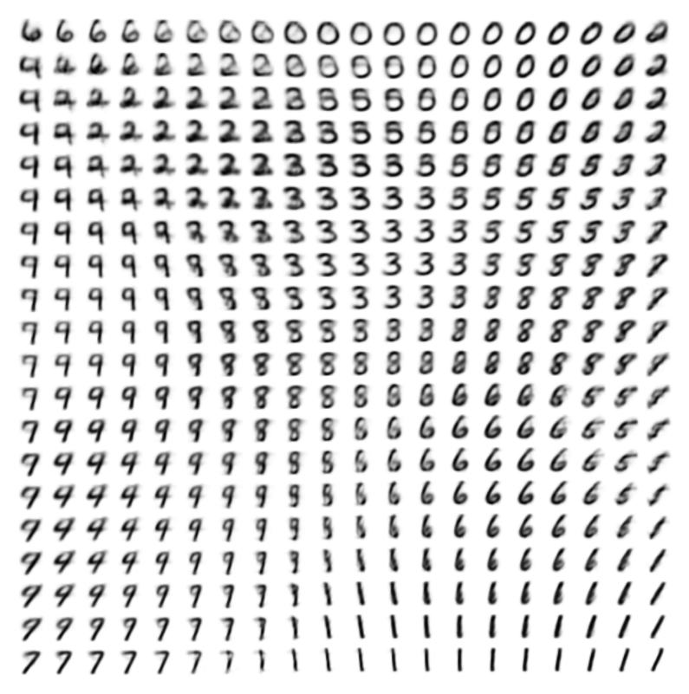
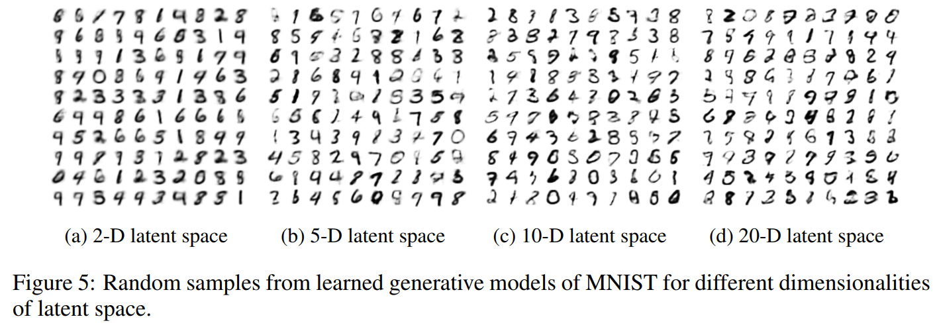
Variational Autoencoder
During training, the VAE learns both an encoder and a decoder component
For generation, the encoder part is discarded, we start out with the latent vector
We select a random point in the latent space, i.e. a random latent vector
The decoder part calculates an output vector from this random latent vector
Example: output images generated from values in different regions of the latent space of a VAE with a two-dimensional latent space, trained on the MNIST dataset (source: Kingma, Welling 2013)

Slide 15
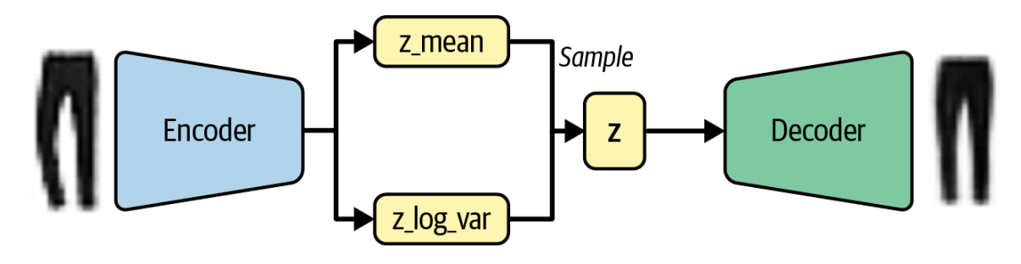
Variational Autoencoder
Images can also be generated with a plain autoencoder
https://github.com/davidADSP/Generative_Deep_Learning_2nd_Edition/tree/main/notebooks/03_vae/01_autoencoder
When using a plain autoencoder, the structure of the latent space is relatively random and unconstrained.
The hidden vectors of the training examples may all be located very close to each other in the latent space and are not evenly distributed. As a result, it is difficult to predict from which region we should sample random vectors in order to generate good images.
A variational autoencoder (VAE) differs from a plain autoencoder in that each training sample is not mapped to a single point in the latent space, but to a mean value and a variance.
During training, the decoder does not decode the mean value directly — instead, a random sample is drawn from the distribution defined by the mean and variance, and that sample is decoded.
Consequence: All points around the mean should produce images that are quite similar to the input image.

Slide 16
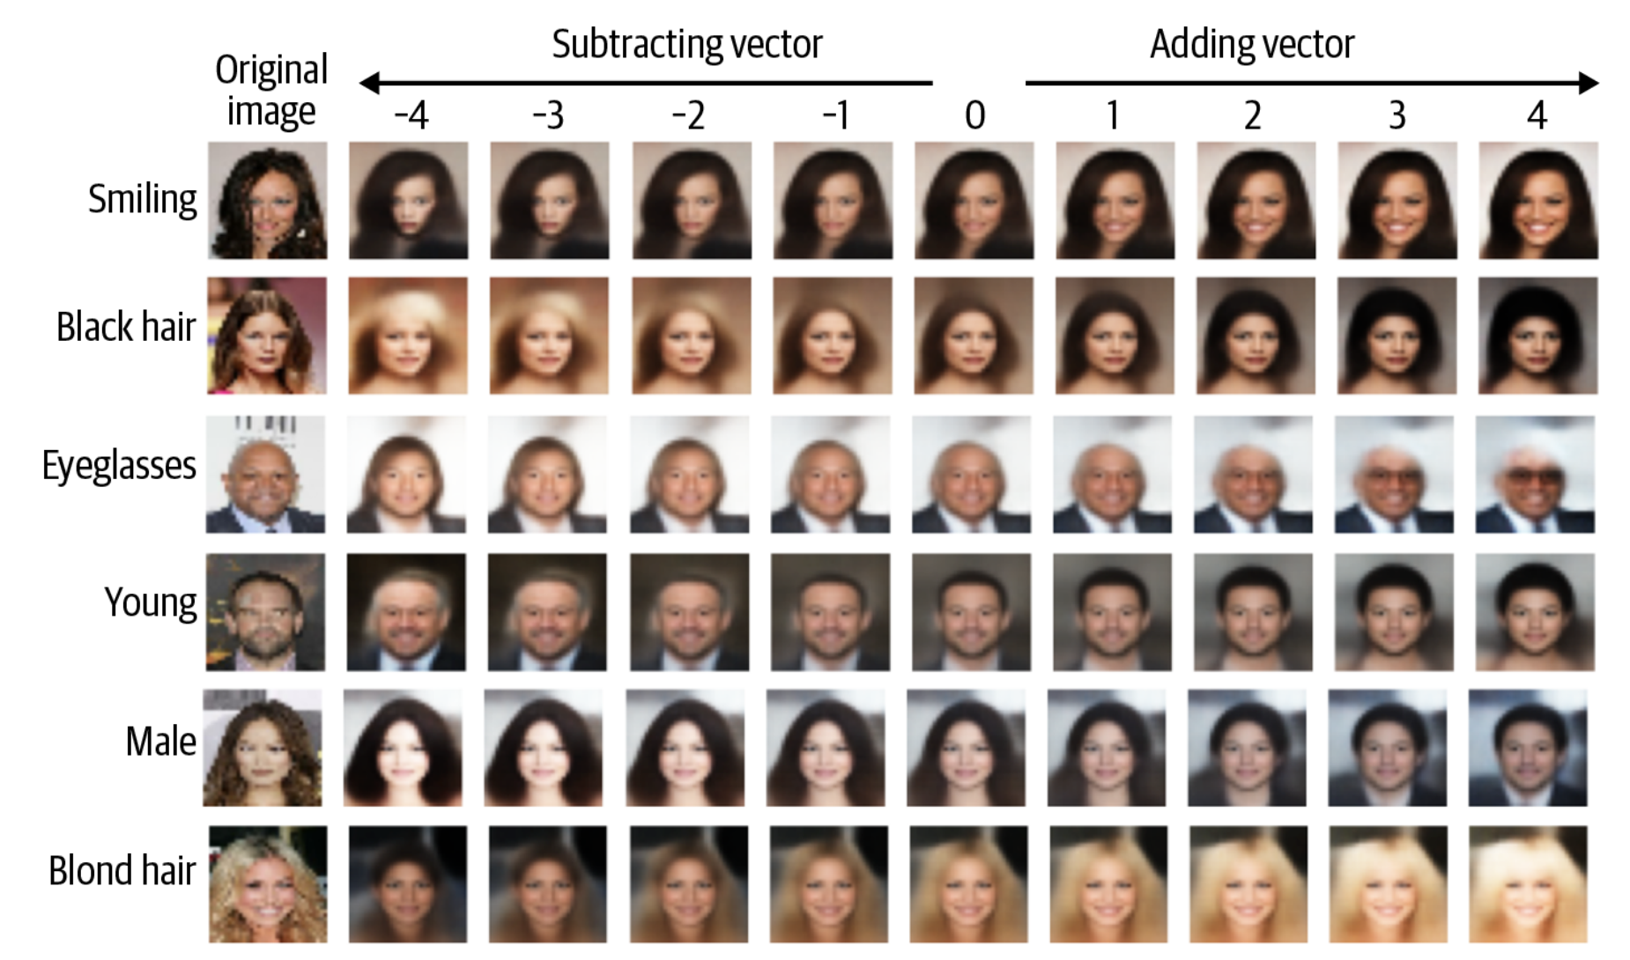
Operations on Latent Vectors
Each output image corresponds to a vector in the latent space
Arithmetic operations can be performed on these vectors — for example, they can be added together or their mean can be calculated.
For instance, in the CelebFaces Attributes dataset on Kaggle, each image has associated attributes such as eyeglasses, black hair, blond hair, old, etc.
If we average all the vectors of images of people wearing glasses and subtract the average of vectors of all images of people without glasses, we obtain a “glasses vector.”
By adding this glasses vector to the latent vector of an image of a person without glasses, we can generate approximately the same person wearing glasses.
Source: Foster: Generative Deep Learning, 2nd ed., O’Reilly, 2024, 92.

Slide 17
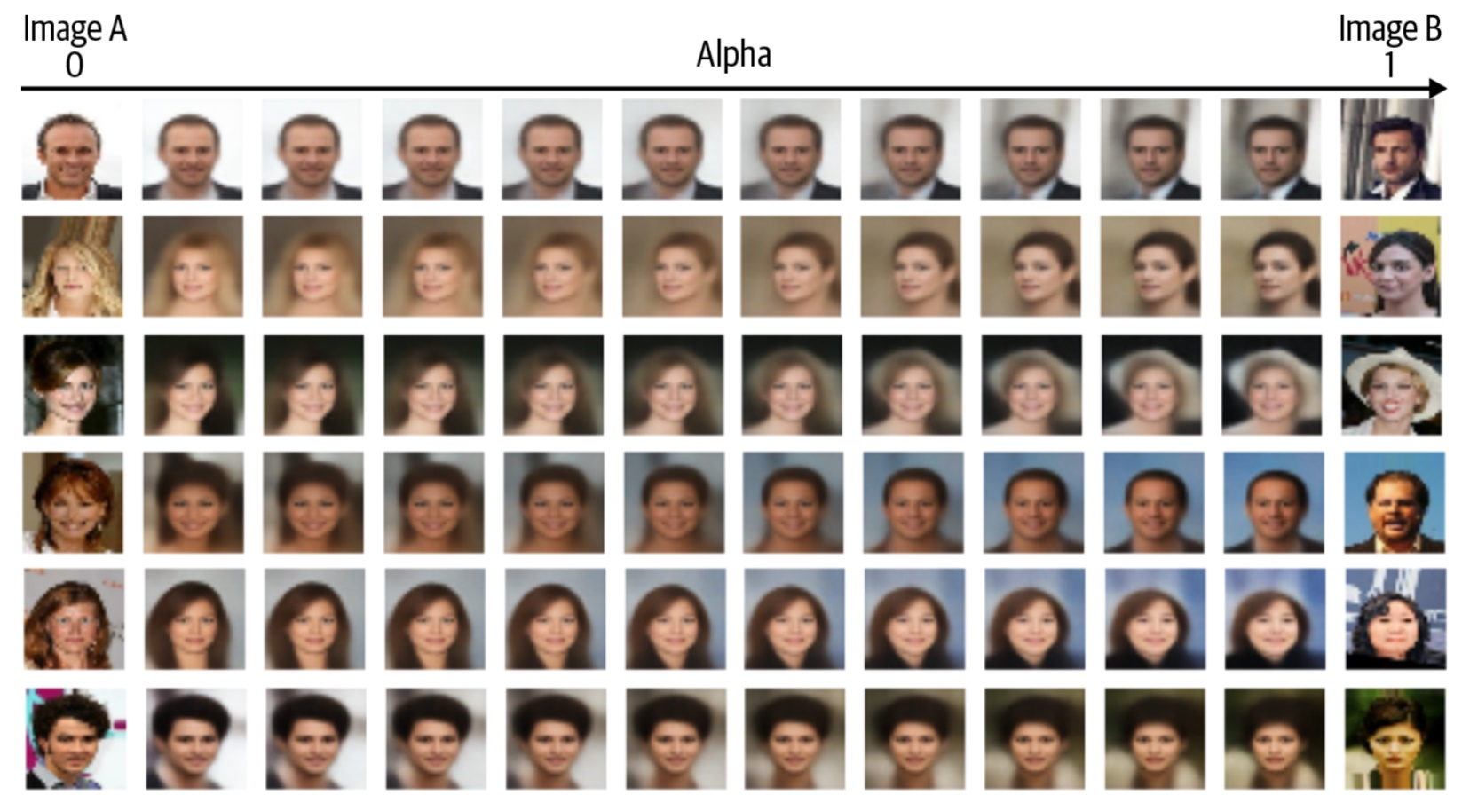
Operations on Latent Vectors
We can start out with two vectors, a and b
If going from a along the path of vector b–a we decode the points of the vector space, we get a gradual transition (so-called morphing) from image a to b
a + α(b–a) Sourse: Foster, op.cit., 93.

Slide 18
GAN
Goodfellow és mtsai, Generative Adversarial Networks, 2014
The term adversarial (suggesting competition or rivalry) refers to the training architecture.
Two deep neural networks are trained in parallel, alternately:
a generator, which creates images, and
a discriminator, which classifies the received images as either generated or real (a binary classifier).
It is similar to a VAE in that during inference (generation), only one part of the architecture is used — the other part is only needed during training.
Furthermore, the structure of the generator network is similar to the decoder in a VAE:
its input is a continuous numerical vector, initialized randomly,
its output is an image of some fixed size (e.g., 64 × 64 pixels).
However, there is no encoder, neither during training nor during inference.

Slide 19
Training a GAN
We generate a number of random images (e.g., 1000) from random input vectors using the generator.
The training dataset consists of real images, and we want to train the model to generate images similar to these (as in the case of the VAE).
The real images are labeled with 1, and the generated images are labeled with 0.
We train a binary classifier neural network (for example, a deep convolutional neural network with a fully connected layer before the output and a sigmoid activation) to distinguish between the two classes of images.
Then we train the generator:
We move the vector of each generated image in the direction of the correct side of the decision boundary,
and adjust the generator’s weights using gradient descent so that, for each random input vector, it produces outputs that more closely approximate this more real-looking image.
We then start over: Generate new random images with the current weights of the generator, train the discriminator on these new generated images and on the real training images.
We alternate between training the two networks — one in one step, the other in the next.

Slide 20
Training a GAN
The generator’s goal is to produce images that are indistinguishable from real ones.
The discriminator’s goal is to accurately distinguish generated images from real ones.
Training of a GAN would be successful if the generator produced images that the discriminator could not tell apart from the real images.
If we train the discriminator on an equal number of real and generated images, then for test images — both real and generated — it would classify them as real and fake with 50–50% probability each.
In practice, however, GAN training rarely reaches this ideal state. The discriminator usually achieves an accuracy close to 1, meaning it can reliably tell the two classes apart.

Slide 21
Developments of GAN
GAN was invented in 2014, but only became very popular a few years later, starting in 2017 in image generation
(at least) hundreds of various versions have been proposed (WGAN, StyleGAN, Progressive GAN, etc.)
the basic idea, combining a discriminator and a generator, are always present
details of the implementation were refined
details of training procedure
generator uses different neural network architectures
conditional generation:
the generator does not generate an arbitrary image, but one out of a set of several classes, e.g. a dog
the discriminator does not just decide whether the image is real or generated, but also what class of object it depicts

Slide 22
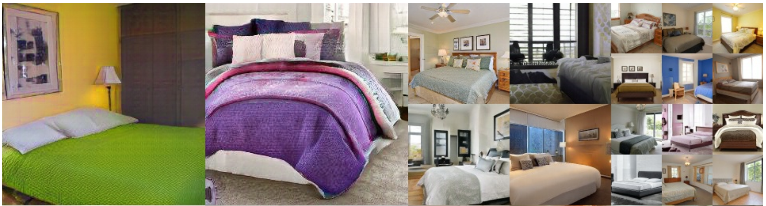
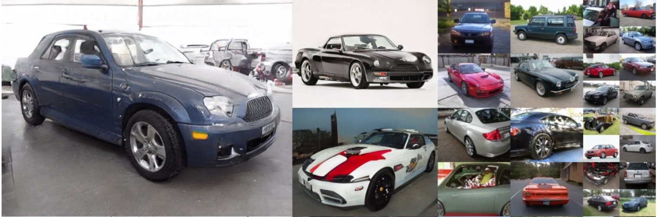
GAN
Especially good at generating faces, but also used successfully for generating other things: bedrooms, cars, etc.
Source: Karras et al.: A Style-Based Generator Architecture for Generative Adversarial Networks, 2018

Slide 23
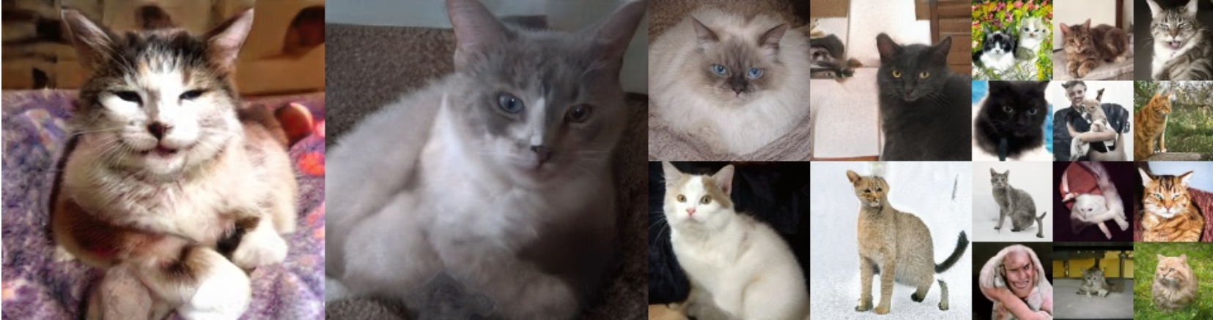
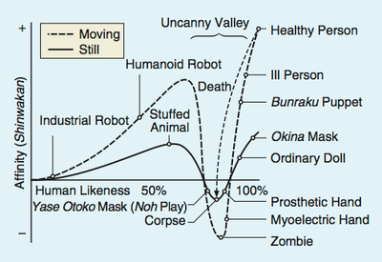
The „Uncanny Valley” Effect
It was first recognised in robotics that as an artificial (robotic) face or body part starts to look more and more like that of a human (or animal), the more appealing it it to humans.
Mori, Bukimi no tani [Uncanny valley], Energy 7, 33–35, 1970.
Up to a certain point, when it becomes very similar to a real face etc., but not exactly like it; from this point on, the face or body part becomes uncanny, or in other words, unsettling, repulsive or frightening.
This can be observed in connection with generated images as well: a photorealistic image the details of which are wrong (proportions of a face are not accurate, distorted, parts are missing or not where they should be, skin’s texture is odd, etc.), the image can appear scary or monstrous to a viewer.

Slide 24
Diffusion
Since around 2020, image generation has been dominated by diffusion models
The fundamental idea is about as old as that of the GAN
Sohl-Dickstein et al.: Deep Unsupervised Learning using Nonequilibrium Thermodynamics, 2015
this was further developed by: Ho et al.: Denoising Diffusion Probabilistic Models, 2020
Fundamental idea: denoising
the model is trained to remove some amount of noise from a noisy image in small steps
we have seen similar approaches before:
denoising using non-neural methods
denoising autoencoder
input image is noisy, output is clean, trained on such image pairs
the point is not to create an information bottleneck in the form of a latent vector like in a VAE
inserting learned patterns into noise: DeepDream

Slide 25
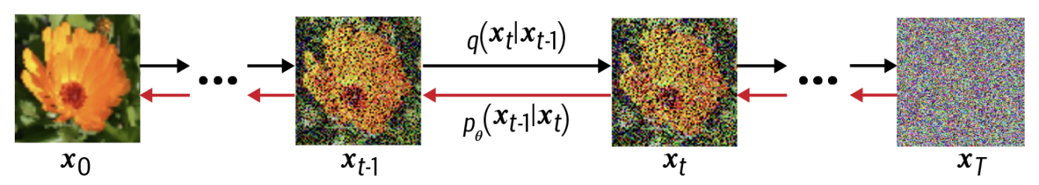
Diffusion
Training:
We scale the pixel values of all training images so that their distribution follows a standard normal distribution (mean 0, variance 1).
We then add Gaussian noise with some variance to the image so that the sum of the noise and the original image always maintains unit variance.
In other words, we gradually move the original image pixels toward zero mean, while increasing the deviation of the added noise from zero
The process of adding noise follows a schedule inspired by thermodynamics:
Initially, we add small amounts of noise (low variance) at each step
then progressively larger amounts — this gradual process gives rise to the term diffusion
During each training step, we feed two images into a neural network:
We generate random Gaussian noise with a given variance (e.g., 0.6), and add it to a “clean” training image — the resulting noisy image is the input
The added noise itself (which could be subtracted from the input to recover the original image) is the target output.
The network’s weights are updated so that it learns to predict the added noise from the noisy image.
training trick: two neural networks are used, one’s weights are updated via backpropagation, the other averages each weight of the first network over recent training steps
This makes training more stable and prevents the weights from fluctuating too much.

Slide 26
Diffusion
The authors of the original 2020 paper that introduced diffusion used a neural network architecture called U-Net to implement training:
deep convolutional neural network
with residual connections
skip over layers
organised into blocks like transformers
similar to an autoencoder:
input and output are of same size with same number of channels (colours)
network consists of two parts:
in the first half, convolutional layers reduce the size (resolution) of the image and increase number of channels (convolutional filters) – downscaling blocks
the other half is the reverse: increase image size, reduce number of layers – upscaling blocks
not flattened into a latent vector in the middle (not needed for generation)
However, other architectures can be used instead, including transformers

Slide 27
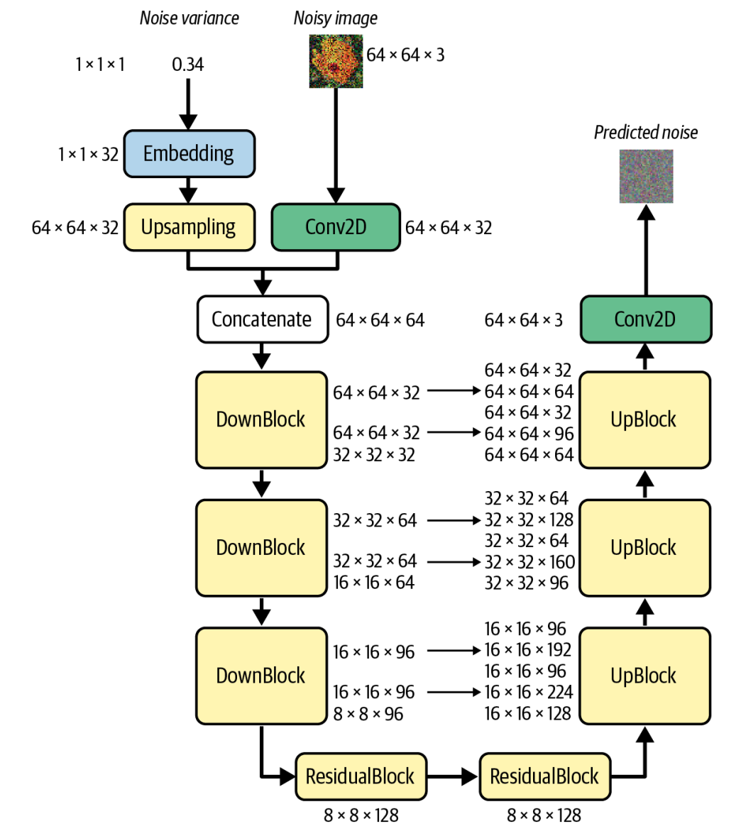
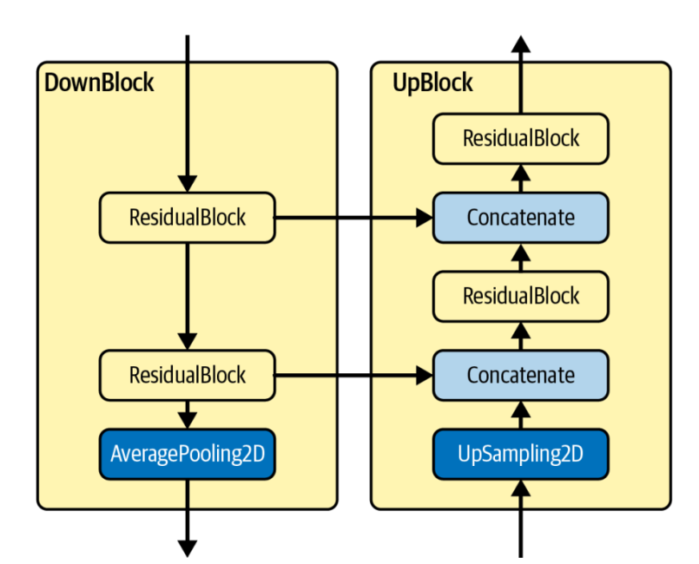
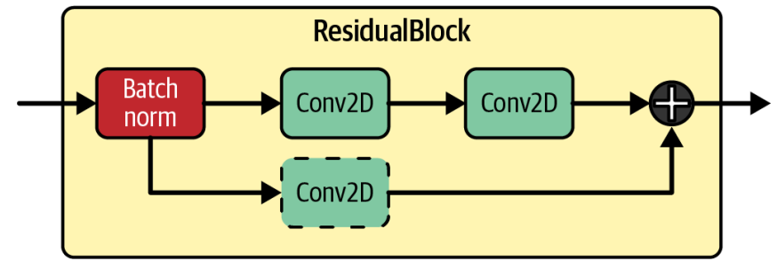
U-Net
Course: Foster, op.cit., 217, 221, 223

Slide 28
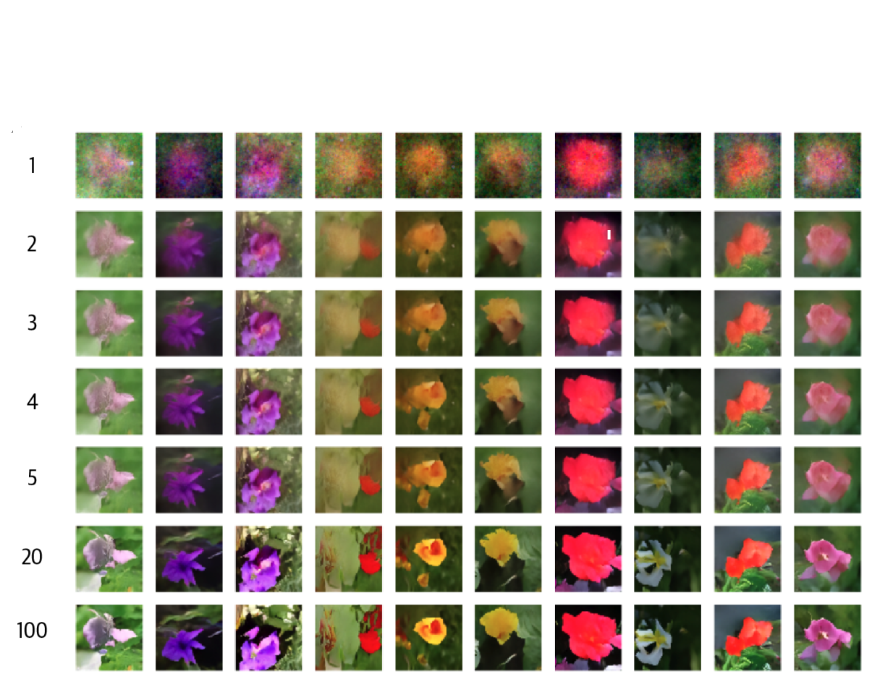
Generating with Diffusion
We pass an image consisting of 100 % noise to the model
It predicts what part of this is noise and what is the clean image; we subtract from the 100 % actual noise a certain proportion of the predicted noise, e.g. 1/20
reverse diffusion
The result is a generated noisy image that is similar to the images in the training set
We iterate and eventually reach the generated clean image in a certain number of steps (e.g. 20) from 100 % noise
If we subtracted all the predicted noise from the generated noise in one step, image quality would be bad
If reverse diffusion is broken up into multiple iterative steps, the perceived quality gradually improves
But: the cost of generation (time, compute) increases linearly with the number of steps

Slide 29
Conditional Image Generation
The image generation architectures seen so far were trained exclusively on images
the model learns the general properties of the images in the training set during training
if we use this model for generation, it will generate images similar to those in the traning set
Image generation applications we are familiar with in practice do not work like this, but rather use a natural language description to generate an image that shows a motif that corresponds to this description
Multimodal generative AI
the text is one modality, the image the other
a deep neural network needs to make the connection between the two modalities during its training and use this for generation

Slide 30
Conditional Image Generation
First important multimodel models (by OpenAI), January 2021:
DALL-E: uses GPT-3 to interpret a text prompt and a VAE decoder for generation of the image from the hidden layer representation of the text
CLIP: specifically for representation learning
given a picture and a text describing it
the model learns to predict which one out of many (about 30,000 as it happens) textual descriptions belongs to the image
400 million image–description pairs were used to train CLIP

Slide 31
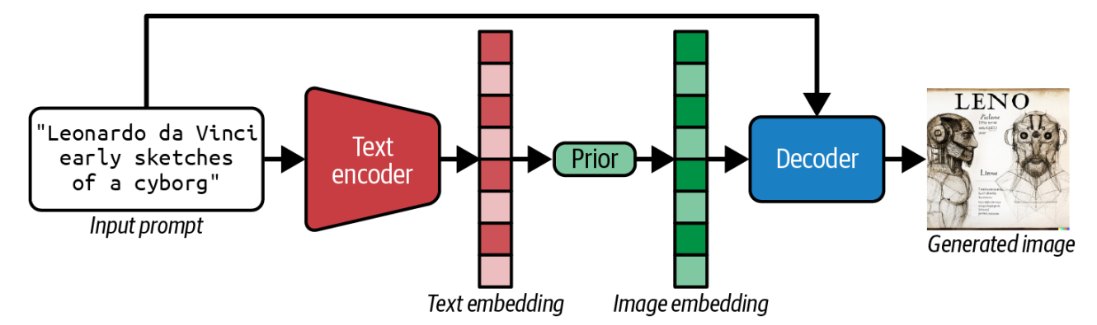
Conditional Image Generation
General schema of the procedure:
we start out with a text, this is transformed by an encoder deep neural network (so-called text embedding model)
this text embedding vector represents the meaning of the text in a vector space (typically hundreds of dimensions; in the most generally used BERT family of encoder language models, it’s 768)
DALL-E 2 uses the CLIP model to calculate the text vector
the vector representing the meaning of the text is transformed into a vector representing the meaning of the image using neural network layers (prior)
the vector representing the image defines a point in a latent vector space, this is decoded using the familiar methods, e.g. a VAE

